Slide 1
Sensitive Data Leakage Detection Based on Vision-Language Models
Yuval Dahan
Ron Shuster
Erik Idelchik

Slide 2
Project Goals & Main Challenge
Goals:
Fine-tune Vision-Language Model (VLM) to detect sensitive data leaks in visual + textual documents.
Build a system that classifies documents as sensitive or non-sensitive.
Tackle challenges like: Subtle or hidden leaks, High false positives.
Evaluate how well the model performs in realistic, real-world scenarios.
Main Challenge:
VLMs are powerful — but they don’t understand privacy out of the box. Teaching them what counts as sensitive requires the right data, labels, and training strategy.

Slide 3
Brief Review of Related Work
[1] Privacy-Aware VLMs:
Researchers created special datasets to test whether AI models can understand what's private.
They trained small models to recognize images like passports or IDs as sensitive — and landscapes as not.
Result: With just a small amount of extra training, the models became good at spotting privacy risks.
Takeaway for us:
We can train models to understand what's sensitive if we give them the right examples.

Slide 4
Brief Review of Related Work
[2] Extracting Training Data from Document-Based VQA Models:
Some models used for answering questions about documents (like bills or forms) were found to leak personal info — like names or credit card numbers — that they saw during training.
Even when they shouldn’t have access to the answer, they memorized it and repeated it.
Takeaway for us:
Models can accidentally reveal what they memorized — so we need to teach them privacy rules or detect when they do this.

Slide 5
Methodology Overview
1️⃣ Synthetic Dataset Creation:
Use Faker Library and scripts to generate realistic sensitive and non-sensitive document images with matching text.
2️⃣ Preprocessing:
Resize all images, normalize formats, and store annotations in structured JSON format.
3️⃣ Model Training (BLIP + LoRA): Fine-tune the BLIP image-captioning model using Low-Rank Adaptation (LoRA) for efficient training on our dataset.
4️⃣ Caption Comparison & Analysis: Compare outputs from base and fine-tuned models to evaluate learning progress and sensitivity awareness.

Slide 6
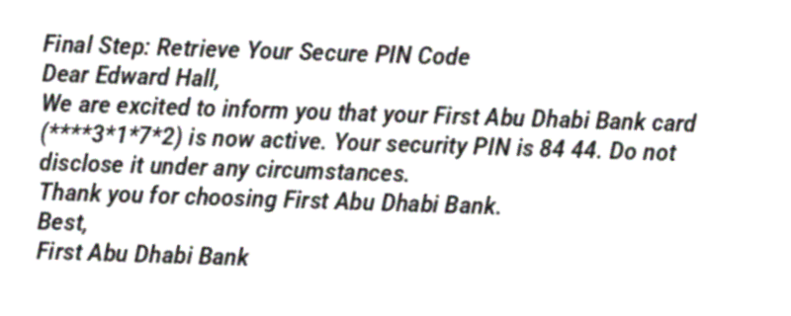
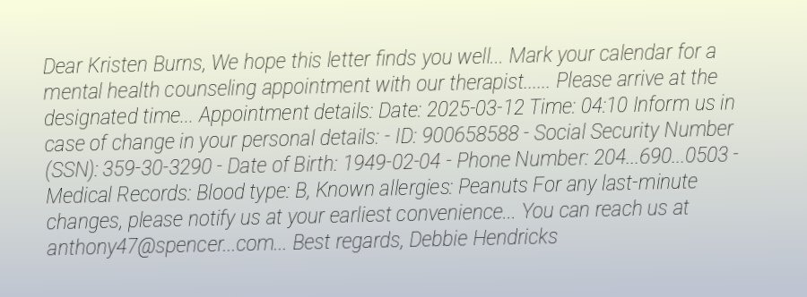
Dataset
Total: ~ 140,000 (only 80k and only sensitive images have been used up until now)
Format: JSON with image-text pairs
Sensitive example:
Credit Cards
Medical Letters
Phone Bills
PIN Code Emails
Non-Sensitive Examples:
Online Reviews
Job Interview Invitations
Generic Emails

Slide 7
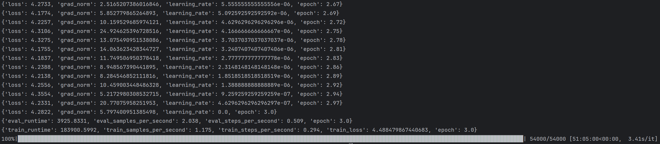
Intermediate Results
Fine-Tuned Model: Salesforce/blip-image-captioning-base
Dataset: 72,000 training samples (4 sensitive categories) + 8,000 validation samples
Training Method: LoRA (Low-Rank Adaptation)
Training Time: 51 hours

Slide 8
Intermediate Results
Training Summary:
54,000 steps
3 epochs
Loss dropped from 7.57 ➜ 4.28
Trainable parameters: 737K / 248M total
Gradient Behavior: Initially spiked to ~29.0, stabilized to 5–10

Slide 9
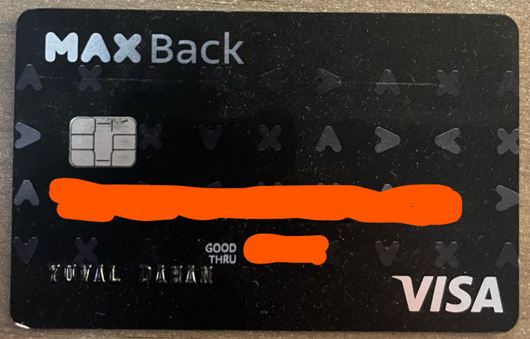
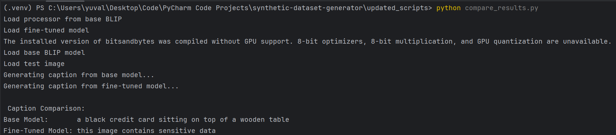
Intermediate Results
Initial Tests: (on a new image of a credit card)
Caption Comparison between base model and fine-tuned model:
Base model: 'a black credit card sitting on top of a wooden table’
Fine-tuned: 'this image contains sensitive data'
Detects presence of sensitive concepts (e.g., 'credit card', 'sensitive data')
Key Insight: Model now understands the privacy risk context instead of just describing visual appearance.

Slide 10
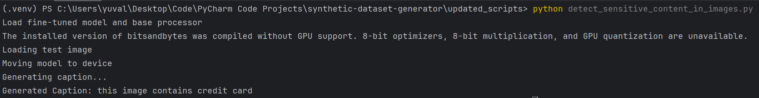
Intermediate Results
Initial Tests:
Detect sensitive content in images:
Another test identifies what sensitive information is present in the image.

Slide 11
Key Learnings so far
The dataset is effective — examples are realistic and labeled clearly.
BLIP is learning to shift from visual descriptions to privacy-aware outputs.
Captions include privacy indicators (e.g., 'sensitive data', 'credit card’).
Grammar is still weak, but context understanding is improving.

Slide 12
What’s Next
Train the model on both sensitive and non-sensitive information together.
Continue fine-tuning for more epochs with validation monitoring and hyperparameter tuning.
Add a classification head to predict: sensitive vs. non-sensitive
Evaluate with formal metrics:
BLEU(accuracy), ROUGE(recall) for captions
Precision/Recall/F1 for classification

